Slide 1


CCNP SWITCH v7.1
Chapter 7: Network Management

Slide 2
Focus on topics
AAA
Identity-based networking
802.1X
NTP, SNTP, and PTP
SNMPv3
2

Slide 3

Authentication, Authorization, and Accounting (AAA)
Notes:
High availability is not just about adding redundant devices. It implies planning to understand where the points of failure occur and designing the network so that an alternative solution exists to compensate for the loss of these points of failure.
This chapters provides an overview on how to implement a high-availability solution according to a given network design and requirements. This includes building a resilient network with optimal redundancy for high availability. Monitoring the network using SNMP, Syslog, and IP SLA are key elements to ensure the high availability of the network.
This chapter also covers supervisor redundancy options such as RPR, RPR+, SSO, and NSF.
For ensuring first hop gateway redundancy, the Hot Standby Router Protocol (HSRP), Virtual Router Redundancy Protocol (VRRP) and Gateway Load Balancing Protocol (GLBP) are needed. First hop redundancy protocols (FHRP) allow for nondisruptive failover between available redundant gateways. HSRP/VRRP allow for one primary router per subnet with other routers acting as standby/backup. GLBP allows load balancing across multiple gateways for the same subnet.
High availability is technology that enables networkwide resilience to increase IP network availability. Network applications must cross different network segments—from the Enterprise Backbone, Enterprise Edge, and Service Provider Edge, through the Service Provider Core. All segments must be resilient to recover quickly enough for faults to be transparent to users and network applications. This chapter describes the high availability concept, how resiliency is built, and how the network is designed to always offer a path between any pair of end points.

Slide 4
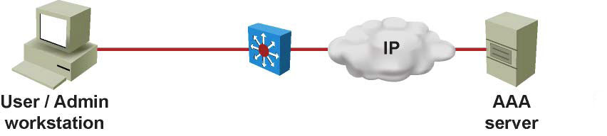
Authentication, Authorization, and Accounting (AAA)
The AAA network-security services provide the primary framework through which you set up access control on a Cisco IOS switch.
AAA is an architectural framework through which the network access control policy is enforced on the networking device by configuring a set of three independent security functions in a consistent manner.
Notes:
Note: Be extremely careful when configuring AAA because you might accidentally lock yourself out of the router or switch, in which case you might need to initiate password recovery to return to the original state.

Slide 5
Authentication
Authentication is the process of identifying a user before that user is allowed access to a protected resource.
A user presents a valid credentials, which are then compared with security information in a user database.
Authentication is usually based on something the user knows (username and password), something the user has (digital certificate issued by certification authority), or something the user is (biometrical scanners which can identify the user by fingerprint or eye retina)
If a match exists, the user is then granted access to the network.
In addition, authentication may offer other services depending on the security protocol selected, such as:
An additional challenge and response
Messaging support
Encryption

Slide 6
Authorization
After the user gains access to the network, authorization is performed.
Authorization allows the control of the level of access users have.
Authorization can define which privilege exec commands are available to the user, or control remote access (allowing the user to use protocols such as Point-to-Point Protocol (PPP) or Serial Line Internet Protocol (SLIP)
For example, when a user tries to perform some specific function, such as configuring an IP address on an interface, AAA will query the authorization server for that specific attribute and used.
Based on reply from the server, the user is then allowed or not allowed to perform that specific function.

Slide 7
Accounting
Accounting is performed after authentication.
Accounting enables the collection of information about the user activity and resource consumption.
You can log user logins, commands executed by the user, session durations, bytes transferred, and so on.
User activity information from all devices in your network is located in one central place.
This information may be leveraged for billing, auditing, and reporting purposes
Authentication can be valid without authorization and accounting.
Authorization and accounting, however, cannot be performed without the authentication.

Slide 8
Advantages of AAA
Increased flexibility and control of access configuration:
AAA offers additional authorization flexibility on a per-command or per-interface level, which is unavailable with local credentials.
Scalability:
As the network grows, managing a large number of users on multiple devices becomes highly impractical and error-prone, with a lot of administrative burden.
Standardized authentication methods:
AAA supports the RADIUS protocol, which is an industry open standard. This ensure interoperability and allows flexibility because you can mix and match different vendors
Multiple backup systems:
You may specify multiple servers when configuring authentication options on the method list common combine them in a server group.
In the event of a server failure, AAA will continue to query the next server from the server group.

Slide 9
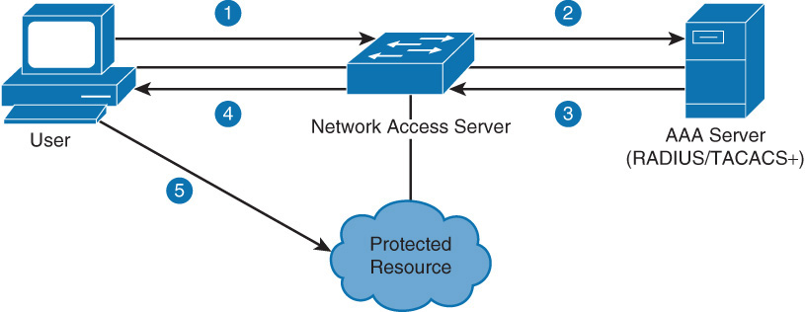
RADIUS and TACACS+ Overview
RADIUS and TACACS+ are AAA protocols.
Both use the client/server model.
Step 1: the user or machine sends a request to a networking device such as a router that acts as a network access server when running AAA.
Step 2 and 3: the network access server then communicates with the server exchanging RADIUS or TACACS+ messages.
Step 4: if authentication is successful:
Step 5: the user is granted and access to a protected resource, such as a device CLI, network and so on

Slide 10
TACACS+ versus RADIUS
Feature | RADIUS | TACACS+
Developer | Livingston Enterprise (now industry standard RFCs2865 and 2866) | Cisco (proprietry)
Transport protocol | UDP ports 1812 and 1813 | TCP port 49
AAA support | Combines authentication and authorization and separates accounting | Uses the AAA model and separates all three services
Challenge response | One-way, unidirectional (single challenge response) | Two-way, bidirectional (multiple challenge responses)
Security | Encrypts only the password in the packet | Encrypts the entire packet body
Note: The early deployment of RADIUS was done using UDP port number 1645 and 1646, which conflicts with the "datametrics" service. Because of this conflict, RFC 2865 officially assigned port number 1812 for RADIUS. Most Cisco devices and applications offer support for either set of port numbers. Some Cisco IOS’s will default to UDP ports 1645 and 1646

Slide 11
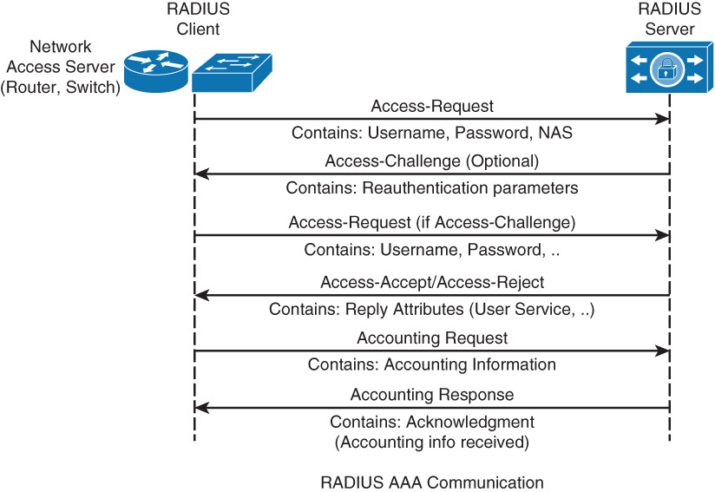
RADIUS Authentication Process

Slide 12
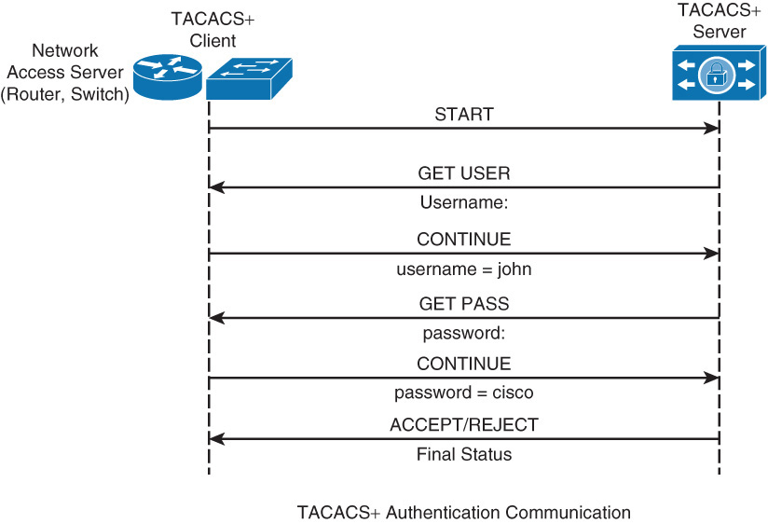
TACACS+ Authentication Process

Slide 13
Configuring AAA
To enable AAA, the first step is to configure the aaa new-model command in global configuration mode.
This step essentially enables AAA capability.
In addition, until this command is enabled, all other AAA commands are hidden.
The aaa new-model command immediately applies local authentication to all lines and interfaces (except console line con 0).
To avoid being locked out of the router, it is a best practice to define a local username and password before starting the AAA configuration.

Slide 14
Configuring RADIUS Access
The first two steps in configuring AAA with radius is to specify configure the radius servers, and add the radius server to a server group.
Switch(config)# radius server configuration-name
Switch(config-radius-server)# address ipv4 hostname [auth-port integer ] [ acct-port integer]
Switch(config-radius-server)# key string
Switch(config)# aaa group server radius group-name
Switch(config-sg-radius)# server name configuration-name
The following is a radius configuration example:
Switch(config)# radius server myRadius
Switch(config–radius-server)# address ipv4 172.16.1.1
Switch(config-radius-server)# key cisco456
Switch(config)# aaa group server radius Mygroup2
Switch(config-sg-radius)# server name myRadius

Slide 15
Configuring RADIUS for Console and vty Access
To configure a login authentication using a named method list radius_list, server group Mygroup2 as primary authentication option, and a local user database as a backup, use the following command:
Switch (config)# aaa authentication login radius_list group Mygroup2 local
The final step is to apply this method list to the VTY 0 – 4 lines:
Switch(config)# line vty 0 4
Switch(config-line)# login authentication radius_list
If the radius server cannot be found the local user database is used
Switch(config)# username User123 secret Secretpwd

Slide 16
Configuring TACACS+ for Console and vty Access
TACACS+ AAA configuration is nearly identical to RADIUS configuration. As with RADIUS, the first step is to configure the TACACS+ servers and then add them to a server group.
Switch(config)# tacacs server configuration-name
Switch(config-server-tacacs)# address ipv4 hostname
Switch(config-server-tacacs)# port integer
Switch(config-server-tacacs)# key string
Switch(config)# aaa group server tacacs+ group-name
Switch(config-sg-tacacs+)# server name configuration-name
Switch(config)# tacacs server myTacacs
Switch(config–radius-server)# address ipv4 192.168.1.1
Switch(config-radius-server)# key cisco123
Switch(config)# aaa group server tacacs+ Mygroup1
Switch(config-sg-radius)# server name myTacacs

Slide 17
Configuring TACACS+ for Console and vty Access
To configure a default login authentication and EXEC authorization with the server group Mygroup1 as primary authentication option, and a local user database as a backup, use the following command:
Switch(config)# aaa authentication login default group Mygroup1 local
Switch(config)# aaa authorization exec default group Mygroup1 local
Note that the default method list automatically applied to all interfaces except those that have a named method list explicitly defined.
The aaa authorization exec command determines if the user is allowed to run an EXEC shell. This facility might return user profile information such as autocommand information, idle timeout, session timeout, access-list and privilege and other per-user factors.
Exec authorization is only carried out over vty and tty lines.

Slide 18
AAA Authorization
AAA authorization has a same rules and can configuration principles as authentication. Therefore, to configure authorization, complete the following steps:
Step 1. Define a named list of authorization methods.
Step 2. Apply that list to one or more interfaces (except for the default method list).
Step 3. The first listed method is used. If it fails to respond, the second one is used, and so on until all listed methods are exhausted. Once the method list is exhausted, a failure message is logged.

Slide 19
AAA Authorization Configuration
Use the command:
aaa authorization {auth-proxy | network | exec | commands level | reverse-access | configuration | ipmobile} {default | list-name} [method1 [method2...]] authorization {arap | commands level | exec | reverse-access} {default | list-name}
Use the aaa authorization command with the group tacacs+ method keywords to request authorization via a TACACS+ server. The group tacacs+ method instructs the switch to use a list of all TACACS+ servers for authentication.
Use the aaa authorization command with the local method keyword to request authorization via the local user database.
Use the aaa authorization command with the group radius method keywords to request authorization via a RADIUS server.
Notes:
Switches and routers use AAA authorization to limit the services that are available to specific users. AAA authorization uses information retrieved from the user’s profile, which is located either in the local user database on the switch or on the security server, to configure the user’s session. Afterward, the switch or router grants access to services requested by the user only if the information in the user profile allows for it. These services include the ability to execute commands, use network access such as PPP, or enter configuration options.
In addition, you should create method lists, which are similar to the AAA authentication configuration, to define authorizations. Method lists are specific to the authorization type requested. The following options are available for AAA authorization:
Auth-proxy: Applies security policies on a per-user basis. With the use of authproxy, each user brings up a web browser to authenticate to a TACACS+ or RADIUS server before accessing the network. Upon successful authentication, the authentication server passes additional ACL entries and profile information to the router or switch to enable the users into the network.
Commands: Applies authorization to all EXEC commands, including configuration commands associated with a specific privilege level. An example is limiting network operation users to only show commands when accessing switches and routers in the enterprise network for normal operations.
EXEC: Refers to the attributes associated with a user EXEC terminal session.
Network: Applies to the types of network connections. An example of using network authorization is authorization granting remote users access to network protocols such as PPP, SLIP, or ARAP during login for remote access.
Reverse access: Refers to reverse Telnet sessions commonly used on console servers for access to different lines.
Similar to the configuration of AAA authentication, AAA authorization uses named method lists in its configuration. AAA supports the following five different methods of authorization:
TACACS+: A client/server method that stores specific rights for users by associating AVPs for each user. The AAA authorization daemon on the Cisco switch or router communicates with the TACACS+ server to determine correct authorization for different options, such as EXEC and network access.
RADIUS: Similar to TACACS+ in that RADIUS is also a server/client model for a Cisco router or switch to request authorization about a specific user. RADIUS servers store specific rights about users by associating specific attributes.
If-authenticated: Enables a user to access any requested function as long as the AAA daemon previously and successfully authenticated the user.
None: Effectively disables authorization for the respective interface.
Local: Uses a database of usernames and passwords configured on the respective switch or router. Local databases on Cisco IOS routers and switches configure using the username command and enable only a subset of feature-controlled functions.

Slide 20
AAA Authorization Example
This configuration example illustrates configuring AAA authorization for users via VTY access for shell commands.
To allow users to access the functions they request as long as they have been authenticated, use the aaa authorization command with the if-authenticated method keyword, as shown.
Switch(config)# aaa new-model
Switch(config)# aaa authorization commands 1 default group tacacs+ if-authenticated
Switch(config)# line vty 0 4
Switch(config-line)# authorization commands 1 default

Slide 21
AAA Accounting
The AAA accounting feature enables you to track the services that users are accessing and the amount of network resources they are consuming.
AAA accounting has the same rules and configurations steps as authentication and authorization:
Step 1. Define a named list of accounting methods.
Step 2. Apply that list to one or more interfaces (except for the default method list).
Step 3. The first listed method is used. If it fails to respond, the second one is used, and so on until all listed methods are exhausted. Once the method list is exhausted, a failure message is logged.

Slide 22
AAA Accounting Types Supported
Network accounting: Provides information for all PPP, SLIP, or ARAP sessions, including packet and byte counts.
Connection accounting: Provides information about all outbound connections made from the network, such as Telnet and rlogin.
EXEC accounting: Provides information about user EXEC terminal sessions (user shells) on the network access server, including username, date, start and stop times, the access server IP address, and (for dial-in users) the telephone number from which the call originated.
System accounting: Provides information about all system-level events (for example, when the system reboots and when accounting is turned on or off).
Command accounting: Provides information about the EXEC shell commands for a specified privilege level executed on a network access server.
Resource accounting: Provides start and stop record support for calls that have passed user authentication.

Slide 23
AAA Accounting Configuration
Use the command:
aaa accounting {system | network | exec | connection | commands level} {default | list-name} {start-stop | stop-only | none} [method1 [method2...]]
Apply the accounting method to an interface or lines using the command:
accounting {arap | commands level | connection | exec} {default | list-name}
Notes:
AAA supports the following six different accounting types:
Network accounting: Provides information for all PPP, SLIP, or ARAP sessions, including packet and byte counts.
Connection accounting: Provides information about all outbound connections made from the network, such as Telnet and rlogin.
EXEC accounting: Provides information about user EXEC terminal sessions (user shells) on the network access server, including username, date, start and stop times, the access server IP address, and (for dial-in users) the telephone number from which the call originated.
System accounting: Provides information about all system-level events (for example, when the system reboots and when accounting is turned on or off).
Command accounting: Provides information about the EXEC shell commands for a specified privilege level executed on a network access server.
Resource accounting: Provides start and stop record support for calls that have passed user authentication.

Slide 24
AAA Accounting Example
This configuration example illustrates configuring AAA authorization for users via VTY access for shell commands.
To allow users to access the functions they request as long as they have been authenticated, use the aaa authorization command with the if-authenticated method keyword, as shown.
Switch(config)# aaa new-model
Switch(config)# aaa accounting exec default start-stop group tacacs+
Switch(config)# line vty 0 4
Switch(config-line)# accounting exec default

Slide 25
Limitations of TACACS+ and RADIUS
RADIUS may not be the optimal choice in the following situations:
Device-to-device situations: RADIUS does not offer two-way authentication. It works strictly in a client/server mode, where authentication may be started only from the client side and where the server always authenticates the client. If two devices need to mutually authenticate each other, RADIUS is not appropriate.
Networks using multiple service: RADIUS generally binds a user to a single service model. A single RADIUS server cannot bind a user simultaneously to character (CLI access) and PPP (access to network resources) mode.
Conversely, TACACS+ may not be the optimal choice in the following situations:
Multivendor environment: TACACS+ is a Cisco proprietary protocol.
When speed of a response from the AAA services is of concern: TACACS+ uses TCP as a transport protocol mechanism. TCP is a connection-oriented protocol, which means that a connection between the two endpoints has to be established before the data can start to flow. This might cause latency on legacy devices.

Slide 26

Identity-Based Networking
Notes:
Network security vulnerabilities include loss of privacy, data theft, impersonation, and loss of integrity. Basic security measures should be taken on every network to mitigate adverse effects of user negligence or acts of malicious intent. Best practices following these general steps are required whenever placing new equipment in service.
Step 1. Consider or establish organizational security policies.
Step 2. Secure switch device and protocols.
Step 3. Mitigate compromises launched through a switch.

Slide 27
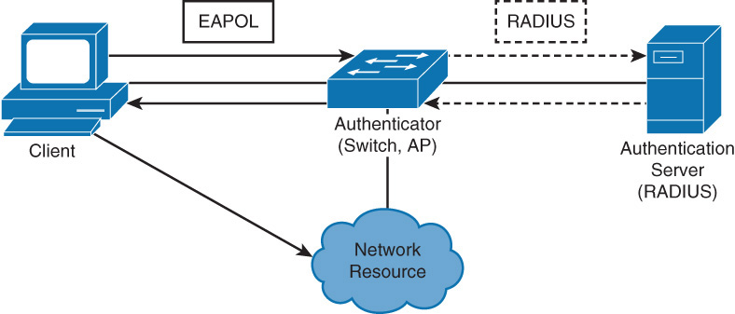
Identity-Based Networking
Identity-based networking is a concept that unites several features to include authentication, access control, mobility, and end use of policy components with the aim to provide and restrict users with the network services that they are entitled to.
From a switch perspective, identity-based networking allows you to verify users once they connect to a switch port.
Identity-based networking authenticates uses and places them in a specific VLAN based on their identity.
Should any users fail to pass the authentication process, the users access can be rejected, or they might be simply put in a guest VLAN.

Slide 28

IEEE 802.1X Port-Based Authentication
The IEEE 802.1X standard that defines a client/server-based access control and authentication protocol that prevents unauthorised clients from connecting to a LAN through switch ports unless they are properly authenticated.
Until the client is authenticated, 802.1X access control only allows Extensible Authentication Protocol over LAN (EAPOL), Cisco discovery protocol (CDP), and Spanning tree protocol (STP) traffic to pass through the port which the client is connected. After authentication is successful, normal traffic and passed through the respective port.

Slide 29
802.1X Roles
■ Client (or supplicant): The device that requests access to LAN and switch services and then responds to requests from the switch. The workstation must be running 802.1X-compliant client software.
■ Authentication server: Performs the actual authentication of the client. The authentication server validates the identity of the client and notifies the switch whether the client is authorized to access the LAN and switch services. The RADIUS security system with EAP extensions is the only supported authentication server.
■ Switch (or authenticator): Controls physical access to the network based on the authentication status of the client. The switch acts as an intermediary (proxy) between the client and the authentication server, requesting identifying information from the client, verifying that information with the authentication server, and relaying a response to the client.
Notes:
With 802.1X port-based authentication, the devices in the network have specific roles, as follows:
Client: The device (workstation) that requests access to LAN and switch services and then responds to requests from the switch. The workstation must be running 802.1X-compliant client software, such as what is offered in the Microsoft Windows XP operating system. (The port that the client is attached to is the supplicant [client] in the IEEE 802.1X specification.)
Authentication server: Performs the actual authentication of the client. The authentication server validates the identity of the client and notifies the switch whether the client is authorized to access the LAN and switch services. Because the switch acts as the proxy, the authentication service is transparent to the client. The RADIUS security system with Extensible Authentication Protocol (EAP) extensions is the only supported authentication server.
Switch (also called the authenticator): Controls physical access to the network based on the authentication status of the client. The switch acts as an intermediary (proxy) between the client (supplicant) and the authentication server, requesting identifying information from the client, verifying that information with the authentication server, and relaying a response to the client. The switch uses a RADIUS software agent, which is responsible for encapsulating and decapsulating the EAP frames and interacting with the authentication server.

Slide 30
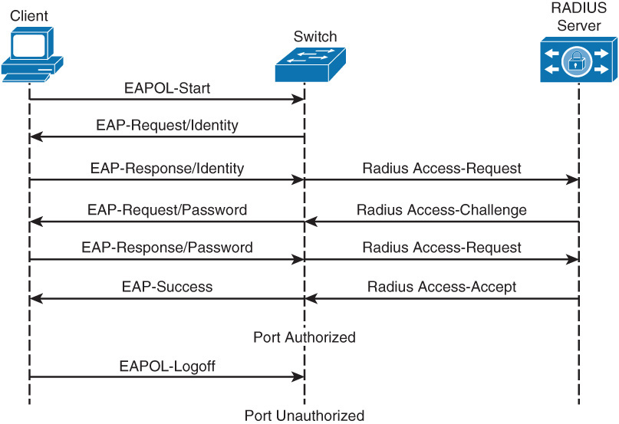
Steps to IEEE802.1X Port-Based Authentication

Slide 31
802.1X Port Authorization State
You control the port authorization state by using the interface configuration command :
dot1x port-control {auto | force-authorized | force-unauthorized}
The auto keyword enables 802.1X port-based authentication and causes the port to begin in the unauthorized state, enabling only Extensible Authentication Protocol (EAP) over LAN (EAPoL) frames to be sent and received through the port.
The authentication process begins when the link state of the port transitions from down to up (authenticator initiation) or when an EAPoL-start frame is received (supplicant initiation).
The switch requests the identity of the client and begins relaying authentication messages between the client and the authentication server.
The switch uniquely identifies each client attempting to access the network by using the client MAC address.
This configuration mode can be used on ports that connect to a 802.1X client.

Slide 32
Configuring IEEE 802.1X
Step 1. Enable AAA:
Switch(config)# aaa new-model
Step 2. Create an 802.1X port-based authentication method list:
Switch(config)# aaa authentication dot1x {default} method1 [method2...]
Step 3. Globally enable 802.1X port-based authentication:
Switch(config)# dot1x system-auth-control
Step 4. Enter interface configuration mode and specify the interface to be enabled for 802.1X port-based authentication:
Switch(config)# interface type slot/port
Step 5. Enable 802.1X port-based authentication on the interface:
Switch(config-if)# dot1x port-control auto

Slide 33
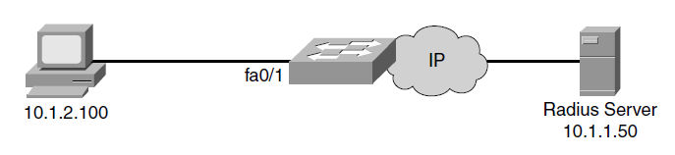
IEEE 802.1X Configuration Example
sw(config)# aaa new-model
sw(config)# radius-server host 10.1.1.50 auth-port 1812 key xyz123
sw(config)# aaa authentication dot1x default group radius
sw(config)# dot1x system-auth-control
sw(config)# interface fa0/1
sw(config-if)# description Access Port
sw(config-if)# switchport mode access
sw(config-if)# dot1x port-control auto
Note: You will not be able to issue dot1x commands on the interface if it is not set to switch port mode access first. The default status which ports varies between switches, but is not commonly set to the access mode.
Notes:
The figure shows a scenario where a PC is attached to FA0/1 on the switch and the device is getting authenticated via 802.1X with a Radius server. The configuration is also shown for the scenario.

Slide 34
Network Time Protocols
Notes:
Network security vulnerabilities include loss of privacy, data theft, impersonation, and loss of integrity. Basic security measures should be taken on every network to mitigate adverse effects of user negligence or acts of malicious intent. Best practices following these general steps are required whenever placing new equipment in service.
Step 1. Consider or establish organizational security policies.
Step 2. Secure switch device and protocols.
Step 3. Mitigate compromises launched through a switch.

Slide 35
The need for Accurate Time
Keeping consistent time across network devices in your network will ensure that you can properly read log messages and other information critical to troubleshooting.
One example of the need for accurate time is for public key infrastructure that is based on X.509 certificates. These certificates are valid for a specific period.
Another example is that accurate time is also essential for logging events in your network, such as syslog.
From a best practice perspective, it is recommended to set clocks on all network devices to Coordinated Universal Time (UCT) regardless of their location. The time zone can then be configured to display the local time if desired.
Accurately time-synchronizing network devices aids in troubleshooting root cause events in the network.

Slide 36
Configuring the System Clock Manually

Slide 37
Setting Summer Time
clock summer-time zone recurring [ week day month hh:mm week day month hh:mm [offset]]
clock summer-time zone date date month year hh:mm date month year hh:mm [ offset ]
clock summer-time zone date month date year hh:mm month date year hh:mm [ offset ]

Slide 38
Setting Summer Time

Slide 39
Network Time Protocol Overview
Manually setting the clocks of any network device is neither accurate nor scalable.
The best practice is to use Network Time Protocol (NTP), Simple NTP (SNTP), or Precision Time Protocol (PTP)
NTP is designed to synchronize the time throughout an entire network infrastructure, including servers, switches, routers, host machines, wireless access points, uninterruptible power supply (UPS), and so on.
NTP leverages UDP port 123 for both the source and destination by default.
Notes:
Sample NTP setup where the NTP is sourcing time from an atomic clock, Global Positioning System (GPS), or other accurate time source and sending NTP info out on the network to synchronize devices.

Slide 40
Network Time Protocol Overview
An NTP network usually gets its reference time from an authoritative time source, such as a radio clock, GPS, or an atomic clock attached to an NTP time server somewhere in the network.
NTP then distributes this time across the network.
Accurate timekeeping is made possible by exchanging NTP messages between each pair of machines (server/client) with an association.
However, in a LAN environment, NTP can be configured to use IP broadcast messages instead.
To keep accuracy of time, NTP uses the concept of a stratum to describe how many NTP hops away a machine is from an authoritative time source.
A machine running NTP automatically chooses the machine with the lowest stratum number

Slide 41
NTP: Stratum
NTP avoids in two ways synchronizing to a machine whose time may not be accurate.
NTP never synchronizes to a machine that is not synchronized itself.
NTP compares the time that is reported by several machines and will not synchronize to a machine whose time differs significantly from the others, even if its stratum is lower.

Slide 42
NTP Modes
A device may take on more than one role at a time.
Server
Provides accurate time information to clients on the network.
Client
Synchronizes its time to an NTP server. This mode is most suited for file server and workstation clients that are not required to provide any form of time synchronization to other local clients. It can also provide accurate time to other devices.
Peers
Peers only exchange time synchronization information.
Broadcast/multicast
Special “push” mode of NTP server where the local LAN is flooded with updates; used only when time accuracy is not an issue.

Slide 43
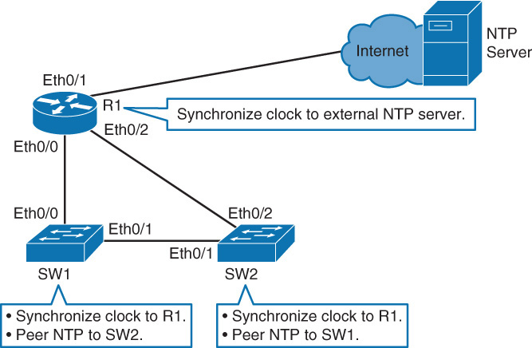
NTP Example
As shown below, the external clock source on the Internet has an IP address of 209.165.200.187.
On R1 the following command is entered:
R1(config)#ntp server 209.165.200.187
When configuring NTP servers, a best practice is to configure more than one NTP server. To specify a preferred NTP server as the primary NTP server, use the:
ntp server ip-address prefer command.
209.165.200.187
Keep in mind that any network management security access lists will need to allow NTP connections.
An example entry for an NTP entry is as follows:
access-list acl-number permit udp host NTP-host-IP eq ntp

Slide 44
Show NTP Associations and NTP Status
We can verify the synchronization with the public server as follows:
R1#show ntp associations
address ref clock st when poll reach delay offset disp
*~209.165.200.187 .LOCL 1 24 64 17 1.000 -0.500 2.820
* sys.peer, # selected, + candidate, - outlyer, x falseticker ~ configured
R1#show ntp status
Clock is synchronized, stratum 2, reference is 209.165.200.187
nominal freq is 250.000 Hz, actual freq is 250.000 Hz, precision is 2**10
ntp uptime is 1500 (1/100 of seconds), resloution is 4000
reference time is D765274D.D51A0546 (14:03:57.832 UTC Mon Jul 7 2014)
clock offset is 0.0000 msec, root delay is 0.00 msec
root dispersion is 630.22 msec, peer dispersion is 189.47 msec
loopfilter state is ‘CTRL’ (Normal Controlled Loop), drift is 0.000000 s/s
system poll interval is 64, last update was 5 sec ago.
Note that NTP can be slow to synchronize. It can take up to 5 minutes for a device to synchronize with an upstream server, especially considering the TNP poll timer is 64 seconds.

Slide 45
Define Local Time Zone and Daylight Savings
By default, IOS-based Cisco device default to UTC time. You need to define a local time zone and daylight savings time to complete the NTP configuration.
NTP will only synchronize the software clock by default on Cisco catalyst switch is running IOS.
If you want NTP also to synchronize a hardware clock, you need to issue the ntp update-calendar command in global configuration mode.
R1(config)# clock time zone AEST +10
R1(config)# clock summer-time AEDT recurring 1 Sun Oct 2:00 1 Sun Apr 3:00
R1# show clock detail
16:30:00 EST Sun Jan 17 2016
Time source is NTP
Summer time starts 02:00:00 EST first Sun 0ct
Summer time ends 02:00:00 EST first Sun Apr

Slide 46
SW1 and SW2 NTP configuration
If R1 has Eth0/0 has an address 10.0.0.1, then for SW1 the configuration would be:
SW1(config)# ntp server 10.0.0.1
SW1(config)# clock time zone AEST +10
SW1(config)# clock summer-time AEDT recurring 1 Sun Oct 2:00 1 Sun Apr 3:00
SW1 should be a stratum 3 device because R1 is a stratum 2 device.
SW1#show ntp status
Clock is synchronized, stratum 3, reference is 10.0.0.1
nominal freq is 250.000 Hz, actual freq is 250.000 Hz, precision is 2**10
reference time is D765274D.D51A0546 (14:03:57.832 UTC Mon Jul 7 2014)
clock offset is 0.0053 msec, root delay is 0.00 msec
root dispersion is 17.11 msec, peer dispersion is 0.02 msec
SW2 would get similar configuration, and would
also be a stratum 3 device.
To configure SW1 and SW2 as NTP peers.
Assuming SW1 and SW2 use the ip address
172.16.0.11 and 172.16.0.12
SW1(config)# ntp peer 172.16.0.12
SW2(config)# ntp peer 172.16.0.11

Slide 47
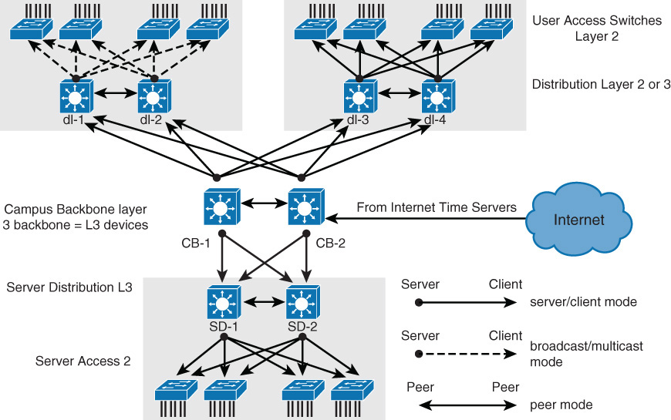
NTP Design Hierarchy
With a flat structure, all routers are configured to peer to each other as NTP peers. Each router will act as both a client and a server with every other router. This however has poor scalability.
A tiered model as shown below is more scalable:

Slide 48
Securing NTP
Cisco devices support only message digest 5 (MD5) algorithm authentication for NTP.
To configure NTP authentication, execute the following steps:
Step 1. Define NTP authentication key or keys is with ntp authentication-key command. Every number specifies a unique NTP key.
Step 2. Enable NTP authentication using the ntp authenticate command.
Step 3. Tell the Cisco device which keys are valid for NTP authentication using the ntp trusted-key command. The only argument to this command is the key that you defined in the first step.
Step 4. Specify the NTP server that requires authentication by using the ntp server ip-address key key-number command. You can similarly authenticate NTP peers by using the ntp peer ip-address key key-number command.

Slide 49
Securing NTP Example
Below illustrates both a server and client configuration for authentication.
NTPServer(config)# ntp authentication-key 1 md5 MyPassword
NTPServer(config)# ntp authenticate
NTPServer(config)# ntp trusted-key 1
NTPClient(config)# ntp authentication-key 1 md5 MyPassword NTPClient(config)# ntp authenticate
NTPClient(config)# ntp trusted-key 1
NTPClient(config)# ntp server 10.0.1.22 key 1

Slide 50
NTP ACL’s
For NTP, you can configure the following four restrictions through access lists:
Peer
Time synchronization requests and control queries are allowed. The device is allowed to synchronize itself to remote systems that pass the access list.
Server:
Time synchronization requests and control queries are allowed. The device is not allowed to synchronize itself to remote systems that pass the access list.
Server-only
Only allows synchronization requests.
Query-only
Only allows control queries.
Notes:
As mentioned previously, once a Cisco router or switch has been synchronized to an NTP source, the Cisco router or switch will act as an NTP server to any device that requests NTP synchronization

Slide 51
NTP Access List Example

Slide 52
NTP Source Address
The source of the NTP packet will be the same as the interface the packet was sent out.
When implementing authentication and access lists, it is good to have a specific interface set to act as the source interface for NTP.
It would be wise to use a loopback interface to use as the NTP source
Router(config)# ntp source looback 0
Router(config)# ntp source 192.168.12.31
If you configured loopback 0 to act as the NTP source for all communication, you can write up just one access list that will allow or deny based on one single IP address of 192.168.12.31

Slide 53
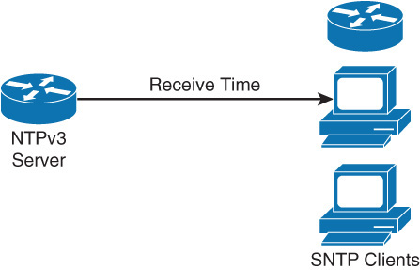
Simple Network Time Protocol (SNTP)
Simple network time protocol (SNTP) is a simplified, client-only version of NTP supported on selected catalyst switches.
SNTP can only receive the time from NTP servers; it cannot be used to write time services to other systems.
SNTP typically provides time within 100 ms of the accurate time, but it does not provide the complex filtering and to statistical mechanisms of NTP
SNTP and NTP cannot coexist on the same machine because they use a same port.
Switch(config)# sntp server 209.165.200.187

Slide 54
PTP/IEEE-1588
Precision Time protocol (PTP) is a similar time synchronization protocol to NTP.
However, its accuracy is much greater than the millisecond-accuracy of NTP; PTP supports accuracy to the sub-microsecond level.
This time of accuracy is needed for defence systems, seismic analysis, data analysis, application analysis, and algorithmic processing.
Currently, Cisco catalyst switches do not leverage PTP for clock synchronization.
However, Cisco Nexus switches used in data's center networks are starting to support PTP.

Slide 55
Simple Network Management Protocol (SNMP)
Notes:
Network security vulnerabilities include loss of privacy, data theft, impersonation, and loss of integrity. Basic security measures should be taken on every network to mitigate adverse effects of user negligence or acts of malicious intent. Best practices following these general steps are required whenever placing new equipment in service.
Step 1. Consider or establish organizational security policies.
Step 2. Secure switch device and protocols.
Step 3. Mitigate compromises launched through a switch.

Slide 56
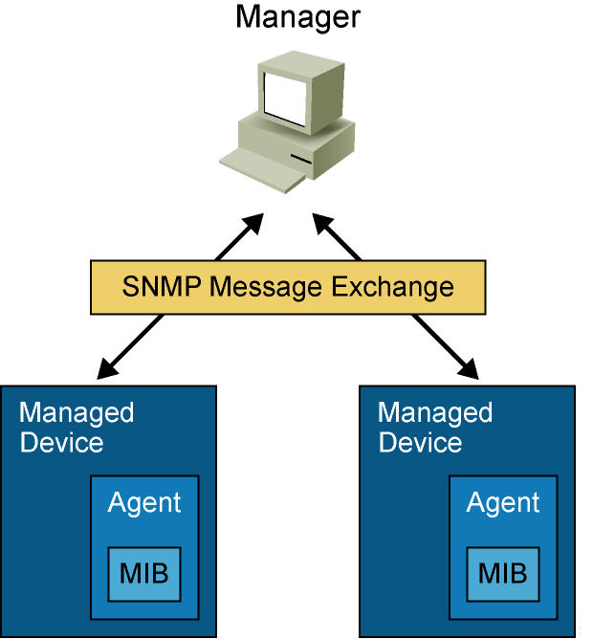
SNMP
SNMP has three elements:
Network Management Application (SNMP Manager)
SNMP Agents (running inside a managed device)
MIB Database object that describes the information in a predetermined format that the agent can use to populate the data.
SNMP defines how management information is exchanged between network management applications and management agents.
Notes:
SNMP has become the standard for network management.
SNMP is a simple solution that requires little code to implement and thus enables vendors to easily build SNMP agents for their products.
Therefore, SNMP is often the foundation of network management architecture.
SNMP defines how management information is exchanged between network management applications and management agents.
A network management application periodically polls the SNMP agents that reside on managed devices by querying the device for data.
The periodic SNMP polling has the disadvantage that there is delay between the time that an event occurs and the time that it is noticed by the NMS.
There is a trade-off between polling frequency and bandwidth usage.
A network management application can display the information in a GUI on the network manager.
SNMP uses the User Datagram Protocol (UDP) transport mechanism of IP to retrieve and send management information, such as MIB variables.
SNMP management agents that reside on managed devices collect and store information about the device and its operation, respond to managerial requests, and generate traps to inform the manager of certain events.
SNMP traps are sent by management agents to the network management system when certain events occur.
Trap-directed notification can result in substantial savings of network and agent resources by eliminating the need for some SNMP polling requests.
The management agent collects data and stores it locally in the MIB.
Community strings control access to the MIB. To view or set MIB variables, the user must specify the appropriate community string for read or write access.

Slide 57
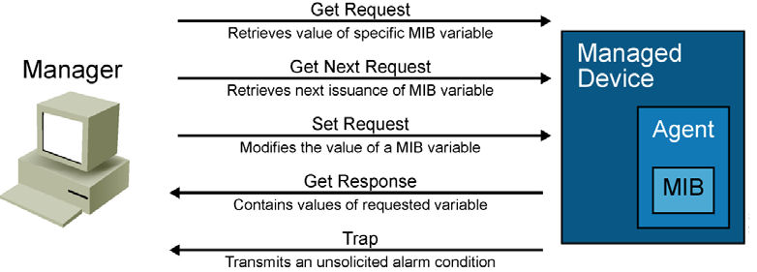
SNMP Version 1
SNMP version 1 (SNMPv1), defined in RFC 1157. Five basic SNMP messages the network manager uses to transfer data from agents that reside on managed devices:
Get Request: Used to request the value of a specific MIB variable from the agent.
Get Next Request: Used after the initial Get Request to retrieve the next object instance from a table or a list.
Set Request: Used to set a MIB variable on an agent.
Get Response: Used by an agent to respond to a Get Request or Get Next Request from a manager.
Trap: Used by an agent to transmit an unsolicited alarm to the manager. An agent sends a Trap message when a certain condition occurs, such as a change in the state of a device, a device or component failure, or an agent initialization or restart.

Slide 58
SNMP Version 2
SNMPv2 introduced with RFC 1441, but members of IETF subcommittee could not agree on the security and administrative sections of SNMPv2 specification. There were several attempts to achieve acceptance of SNMPv2 through release of experimental modified versions.
Community-based SNMPv2 (SNMPv2C), defined in RFC 1901, is most common implementation. SNMPv2C deploys administrative framework defined in SNMPv1, which uses read/write community strings for administrative access.
SNMPv2 introduces two new message types:
Get Bulk Request: Reduces repetitive requests and replies and improves performance when retrieving large amounts of data (e.g., tables).
Inform Request: Alert an SNMP manager of specific conditions. Unlike unconfirmed SNMP Trap messages, NMS acknowledges Inform Request by sending an Inform Response message back to requesting device.
Notes:
SNMPv2 adds new data types with 64-bit counters, because 32-bit counters were quickly outmoded by fast network interfaces.
On Cisco routers, SNMPv2 is implemented in Cisco IOS Software Release 11.3 and later.
Note: Neither SNMPv1 nor SNMPv2 offers security features. Specifically, SNMPv1 and v2 can neither authenticate the source of a management message nor provide encryption.
Because of the lack of security features, many SNMPv1 and v2 implementations are limited to a read-only capability, reducing their utility to that of a network monitor.

Slide 59
SNMP Version 3
SNMPv3 is described in RFCs 3410 through 3415. It adds methods to ensure the secure transmission of critical data between managed devices.
SNMPv3 introduces three levels of security:
noAuthNoPriv: No authentication is required, and no privacy (encryption) is provided.
authNoPriv: Authentication is based on Hash-based Message Authentication Code with Message Digest 5 (HMAC-MD5) or Hash-based Message Authentication Code with Secure Hash Algorithm (HMAC-SHA). No encryption is provided.
authPriv: In addition to authentication, Cipher Block Chaining-Data Encryption Standard (CBC-DES) encryption is used as the privacy protocol.
Security levels implemented for each security model determine which SNMP objects a user can access for reading, writing, or creating and list of notifications that its users can receive.
Notes:
On Cisco routers, SNMPv3 is implemented in Cisco IOS Software Release 12.0 and later.

Slide 60
SNMP Best Practices
Restrict access to read-only.
Use write access with separate credentials and careful consideration
Set up SNMP views to restrict views to only needed sets of MIBs.
Configure ACLs to restrict SNMP access by known managers.
Use SNMPv3 authentication, encryption, and integrity where possible, including upgrading devices to support SNMPv3 if necessary.
Notes:
On Cisco routers, SNMPv3 is implemented in Cisco IOS Software Release 12.0 and later.

Slide 61
Configuring SNMPv3
Step 1. Configure an access list to be used to restrict subnets for SNMP access.
Step 2. Configure the SNMPv3 views to limit access to specific MIBs.
Step 3. Configure the SNMPv3 security groups.
Step 4. Configure SNMPv3 users.
Step 5. Configure the SNMPv3 trap receivers.
Step 6. Configure ifindex persistence to prevent ifindex changes
Notes:
The first step needed for SNMP configuration is to enable SNMP access.
This is done by configuring community strings, which act somewhat like passwords.
The difference is that there can be several community strings, and that each one might grant different forms of access.
In the example, community cisco grants read-only access to the local switch, while xyz123 grants read and write access to the local switch.
The 100 at the end of the snmp-server community lines restricts access to sources permitted via standard access-list 100.
In this case, all stations in subnet 10.1.1.0/24 can access the local switch with both communities cisco and xyz123.
It is critical to choose community strings that are stronger to ensure higher security.
Choose strings that are at least eight charters in length and contain lower/upper CAPS mixed in with special characters and numerals.
The snmp-server trap command has two purposes: It configures the SNMP server and instructs the switch to send its traps to this server.
There are many other SNMP options. Refer to this page for more information: www.cisco.com/en/US/docs/ios/netmgmt/configuration/guide/nm_cfg_snmp_sup_ps6350_TSD_Products_Configuration_Guide_Chapter.html

Slide 62
Configuring SNMPv3
SNMPv3 Best Practice configuration example:
Switch(config)# access-list 99 permit 10.1.1.00.0.0.255
Switch(config)# snmp-server view OPS sysUpTime included
Switch(config)# snmp-server view OPS ifDescr included
Switch(config)# snmp-server view OPS ifAdminStatus included
Switch(config)# snmp-server view OPS ifOperStatus included
Switch(config)# snmp-server view userZ groupZ v3 auth sha secretpwd2 priv aes 256 secondsecretpwd2
Switch(config)# snmp-server enable traps
Switch(config)# snmp-server host 10.1.1.50 traps version 3 priv userZ cpu port-security
Switch(config)# snmp-server ifindex persist
Notes:
The first step needed for SNMP configuration is to enable SNMP access.
This is done by configuring community strings, which act somewhat like passwords.
The difference is that there can be several community strings, and that each one might grant different forms of access.
In the example, community cisco grants read-only access to the local switch, while xyz123 grants read and write access to the local switch.
The 100 at the end of the snmp-server community lines restricts access to sources permitted via standard access-list 100.
In this case, all stations in subnet 10.1.1.0/24 can access the local switch with both communities cisco and xyz123.
It is critical to choose community strings that are stronger to ensure higher security.
Choose strings that are at least eight charters in length and contain lower/upper CAPS mixed in with special characters and numerals.
The snmp-server trap command has two purposes: It configures the SNMP server and instructs the switch to send its traps to this server.
There are many other SNMP options. Refer to this page for more information: www.cisco.com/en/US/docs/ios/netmgmt/configuration/guide/nm_cfg_snmp_sup_ps6350_TSD_Products_Configuration_Guide_Chapter.html

Slide 63
SNMP Command Reference

Slide 64
Chapter 7 Summary
The AAA features include authentication, authorization, and accounting. The use of AAA is required in nearly all campus networks because it secures and provides administrative control and logging of user access to network devices and to the network itself.
Identity-based networking leverages protocols such as 802.1X to support mobility, security, authentication, and authorization of users to network resources.
Accurate time is essential for time logging services in campus networks, as are many security features like encryption.
All Cisco Catalyst switches support NTP for time synchronization.
NTP generally achieves millisecond accuracy in LAN networks.
SNMP is a lightweight protocol that not only monitors and controls devices but also supports alerting of events.
SNMPv3 is the best practice recommendation for SNMP; avoid using SNMPv2 (or v1) if it all possible (because of its lack of security features).
Security around SNMP must be considered as part of any implementation plan. At a minimum, use authentication and encryption along with restricted write access and IP ACLs to restrict network access.

Slide 65
Chapter 7 Labs
CCNPv7.1 SWITCH Lab7.1 NTP
CCNPv7.1 SWITCH Lab7.2 SNMP

Slide 66


